Slide 1
Sales Data
By Lily Wells

Slide 2
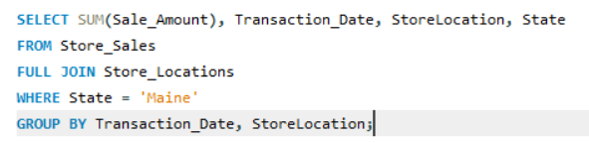
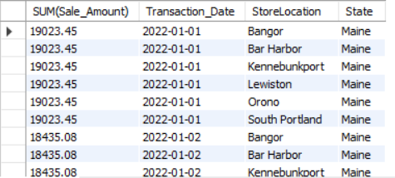
What is total revenue overall for sales in the assigned territory, plus the start date and end date that tell you what period the data covers?

Slide 3
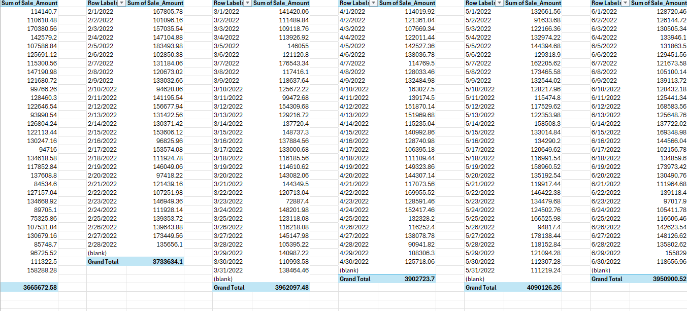
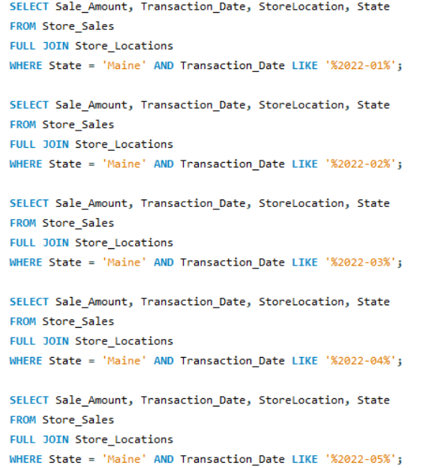
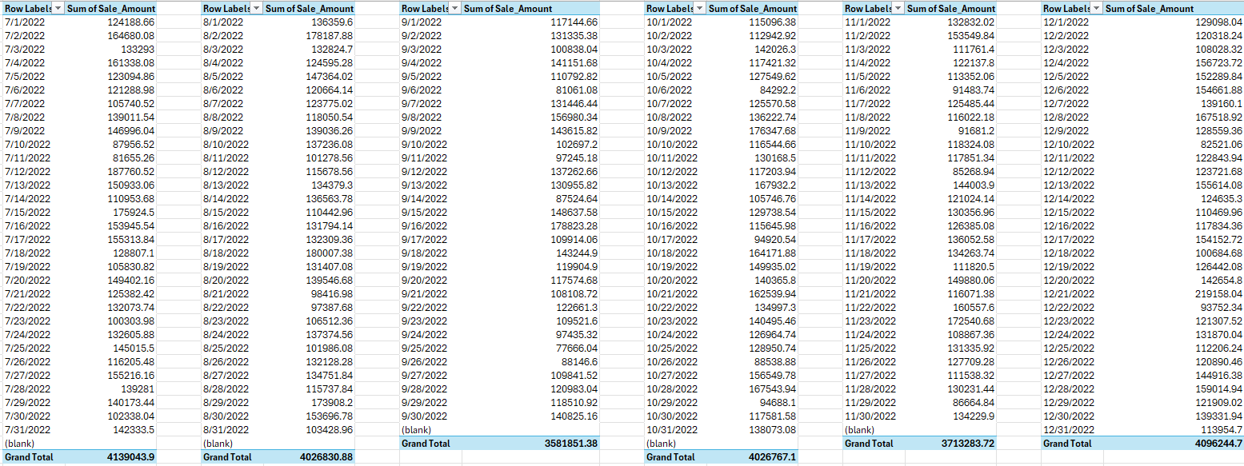
What is the month by month revenue breakdown for the sales territory?

Slide 4
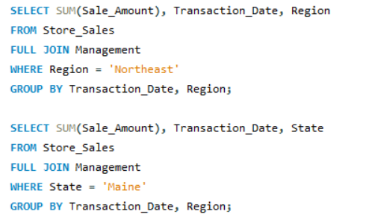
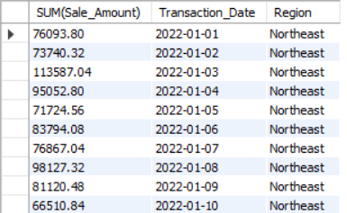
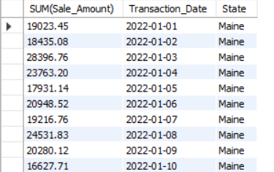
Provide a comparison of total revenue for the specific sales territory and the region it belongs to.

Slide 5

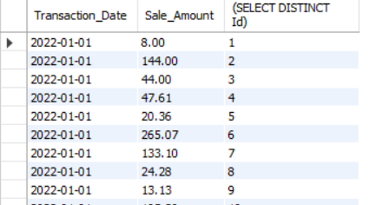
What is the number of transactions per month and average transaction size by product category for the sales territory?

Slide 6
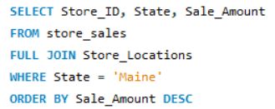
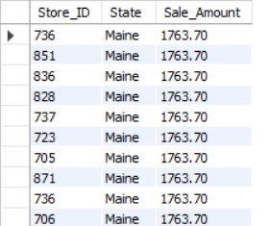
Can you provide a ranking of in-store sales performance by each store in the sales territory, or a ranking of online sales performance by state within an online sales territory?

Slide 7
What is your recommendation for where to focus sales attention in the next quarter?
-- I would recommend that we focus our sales on the highest performing stores in the region (736, 851, 836, etc).
-- Potentially, we could pour our resources into heightening the sales of lower performing stores (Such as 910 or 903) to help them succeed, but I believe focusing on the most successful stores would be better for long-term customer engagement.

